Slide 1
Indian Agriculture
GROUP #18
Sunil Dhaka 17817735
Sanjay Kumar 180669
Gaurav Kumar 170270
Samyak Jain 180661
Uday Kiran Damodara 150775

Slide 2
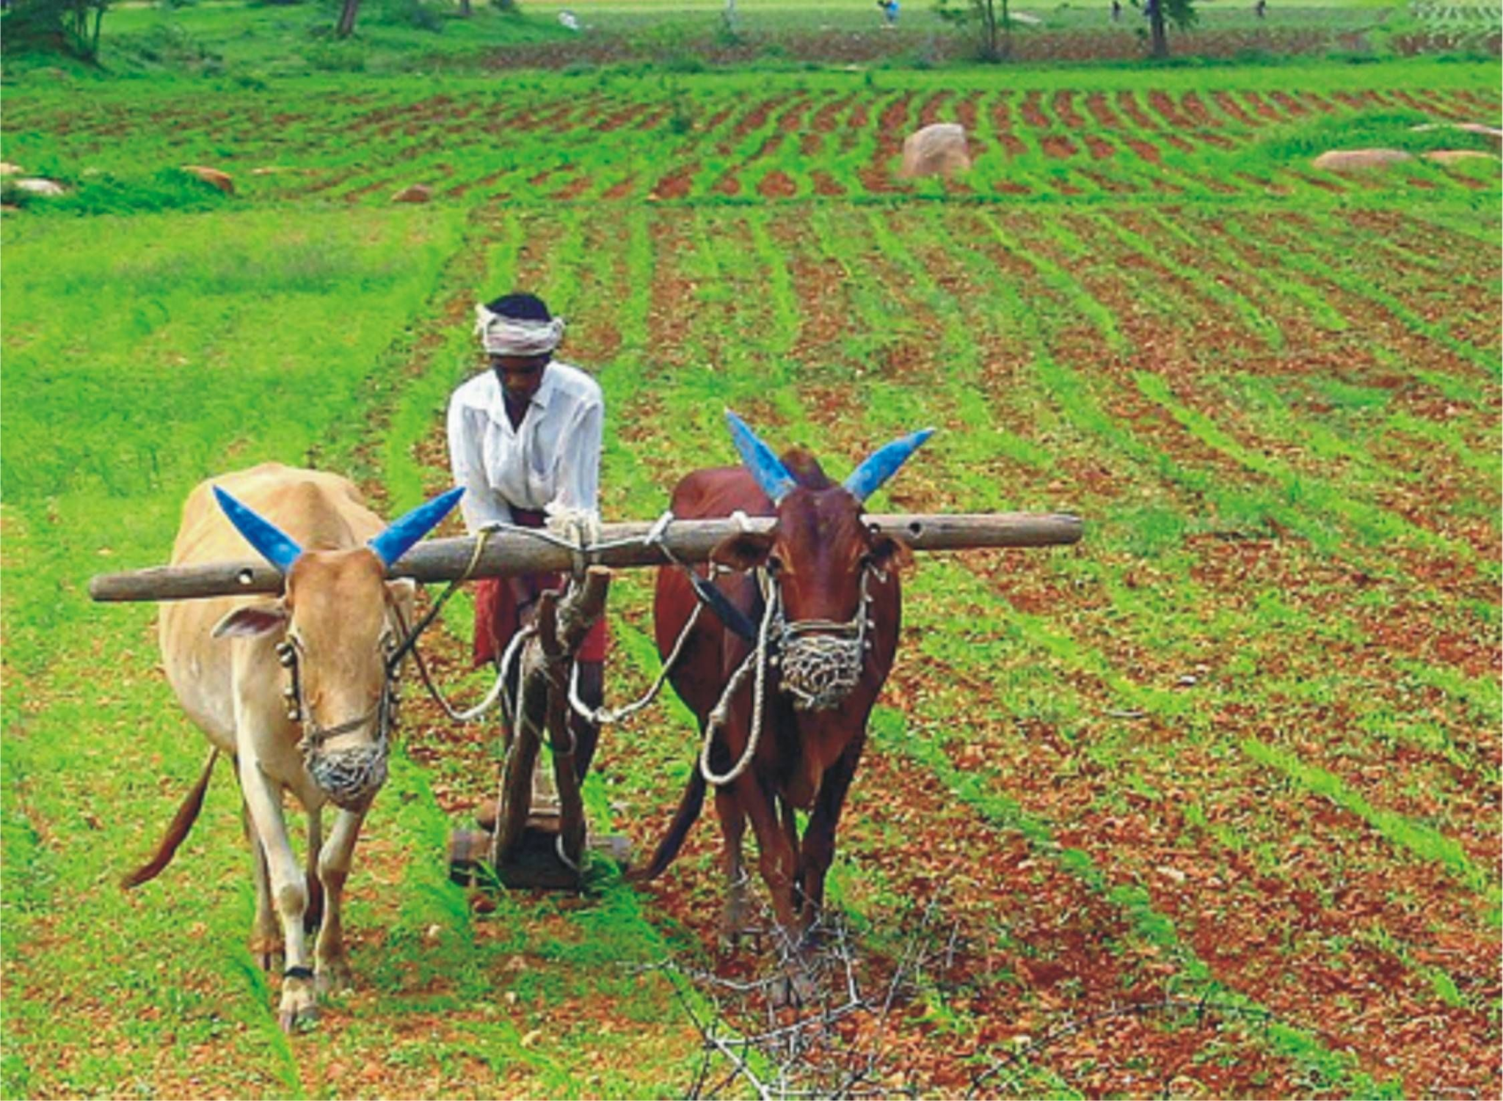
Problem Statement
Analyze Indian crop production data-set and extract key insights
Statewise, zone-wise, cropwise, season-wise, crop-category wise plots of production
Data-set structure and in depth variable analysis(categorical and numeric)

Slide 3
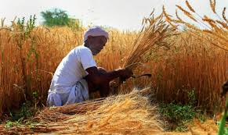
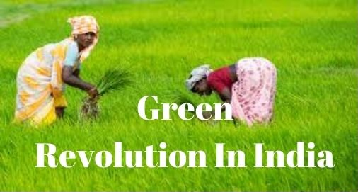
Data.Gov.In
Data Sources
District-wise, season-wise crop production statistics from 1997-2014
This platform provides detailed data for Agricultural analysis

Slide 4
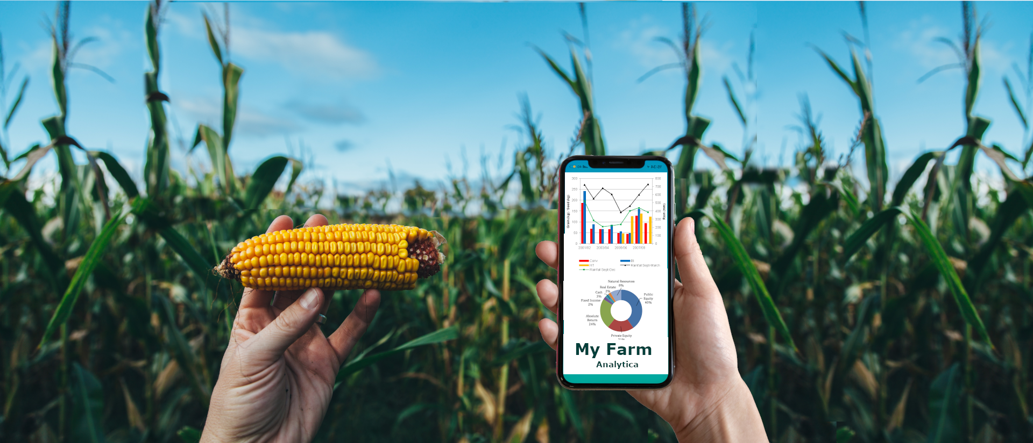
Data, a Closer Look
4 categorical variable
State_Name
District_Name
Season
Crop Type
3 continuous variable
Area (float)
Production(float)
Crop Year(int)
rows: 246091
columns: 7

Slide 5
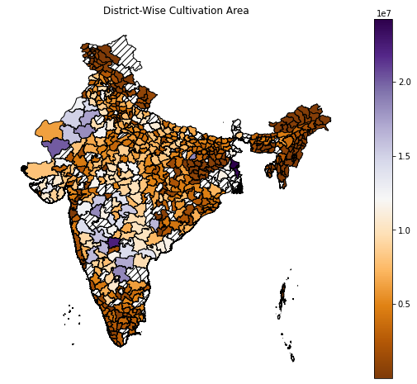
Observations:
- Quite clearly Thar Desert[in Rajasthan] districts have very less cultivation area
- Some in between districts[mainly in central zone due to rocky terrain] that have low cultivation are districts that have water shortage like not having mansoon rain, river or any other source of water.
- In North-East region cultivation area is huge due to heavy mansoon rains, major rivers flows through or near them; basically they have all the waters.
- Souther area also has quite heavy rains in mansoon season and rivers are also there; so as expected they have higher cultivation area.
- Indeed Ganga Plains have high cultivation areas, as expected.

Slide 6
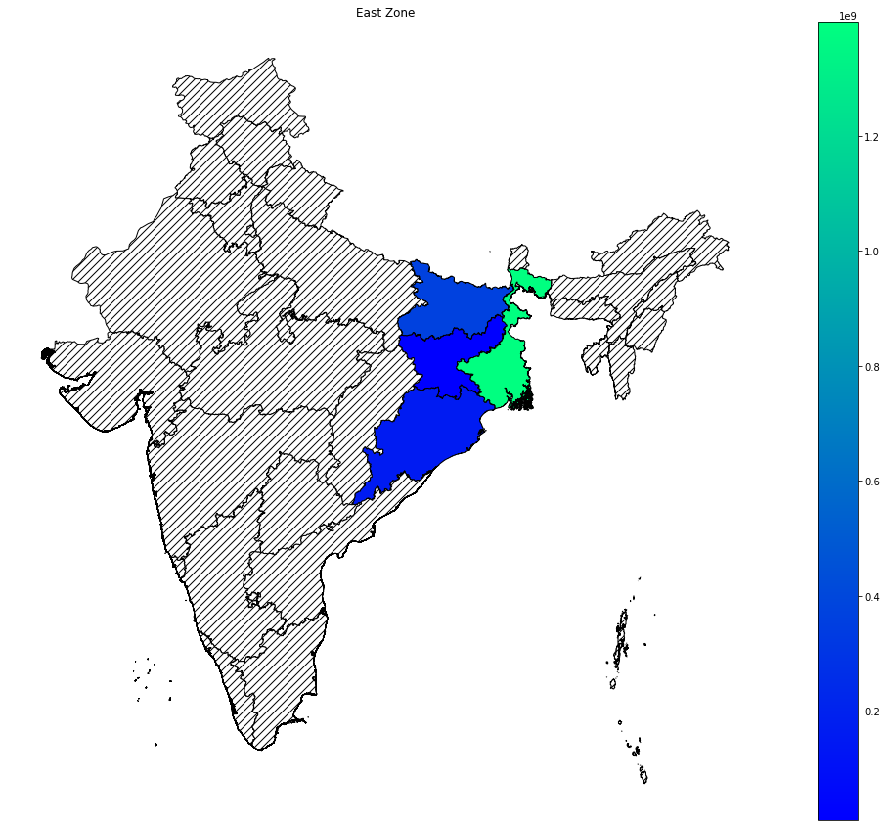
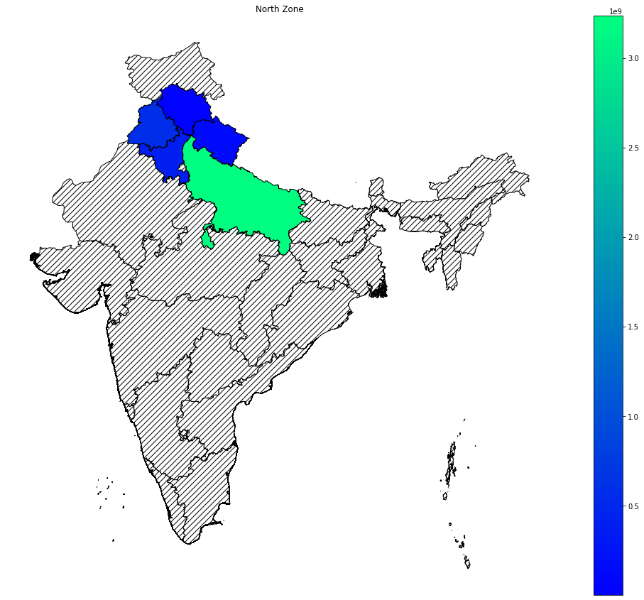
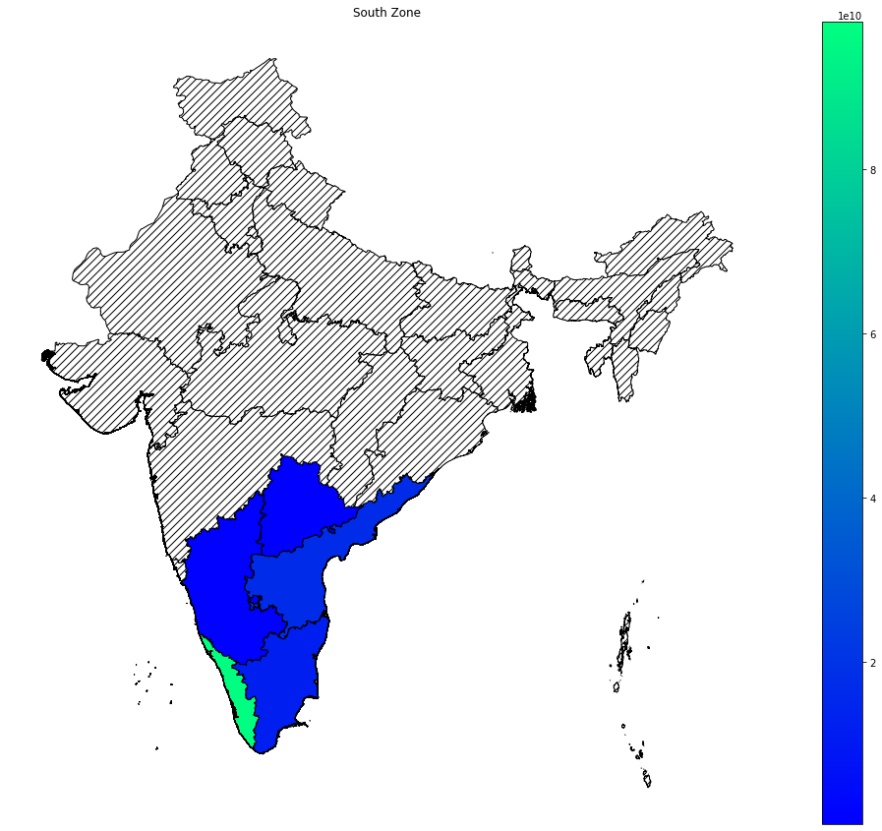
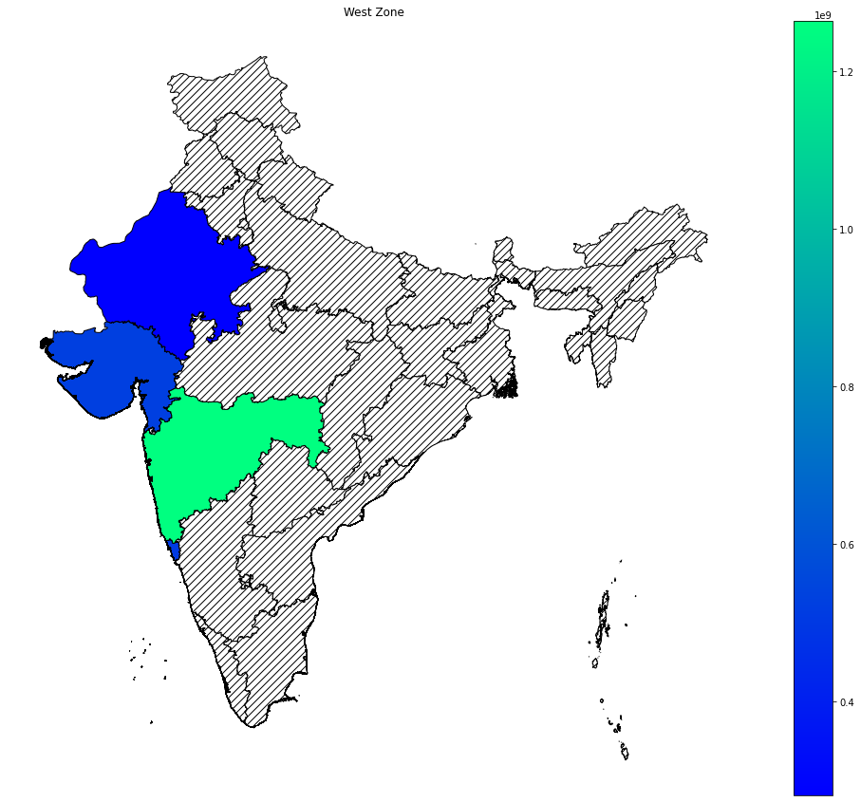
Observations:
- Top producers of crops in each region:
- 'North Zone': Uttar Pradesh
- 'South Zone': Kerela
- 'East Zone': West bangal
- 'West Zone': Maharastra
- 'Central Zone': Madhay Pradesh
- 'NE Zone': Assam
- 'Union Terr': Andman and Nicobars
- Most of the result are not new to our intutions. All states that are in top rank has at least one major river[that flows throughout the year] passing through their cultivation zones.

Slide 7
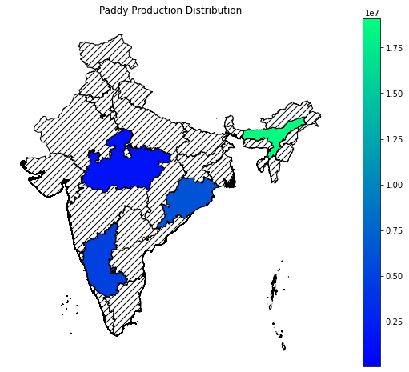
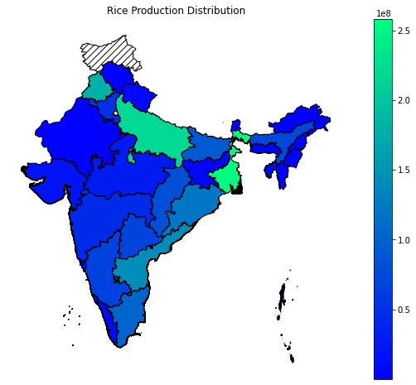
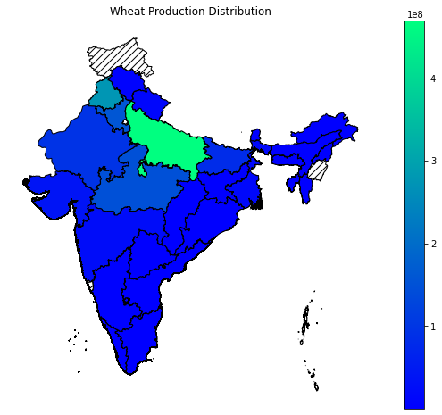
Observation:
- States in North and East specifically Uttar Pradesh, West Bengal, Punjab and Andra Pradesh are top producers of Rice in India over 19 years(1997-2015)
- States in North specifically Uttar Pradesh, Punjab and Hariyana are top producers of Wheat in India over 19 years(1997-2015)
- There are only four states that produce Paddy and Assam is the top producer of Paddy in India over 19 years(1997-2015)

Slide 8
Observations:
- In oilseeds Rajasthan and WB are top producers over 19 years.
- Gujarat and Karnataka are two top states in the production of Nuts.
- In fibers WB, Gujrat, and Maharashtra are top producers over 19 years.
- KT, AP, TG are some top states in the production of Spices.
- In beans MP and MH are top producers over 19 years. There is no beans production data for JH and Assam.
- Tamil Nadu tops in the production of Fruits.
- In Cereals UP, PB and HR are some top producers over 19 years.
- In Pulses MP, UP, and MH are some top producers over 19 years.
- UP and Wb are two top states in the production of Vegetables.
- Uttar Pradesh tops in the production of commercial crops.

Slide 9
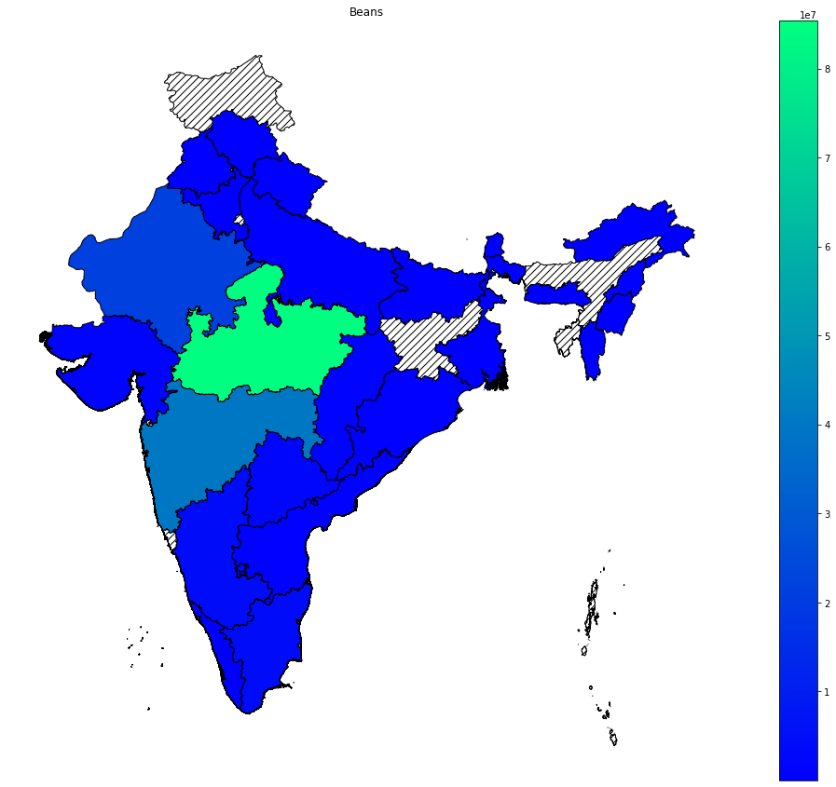
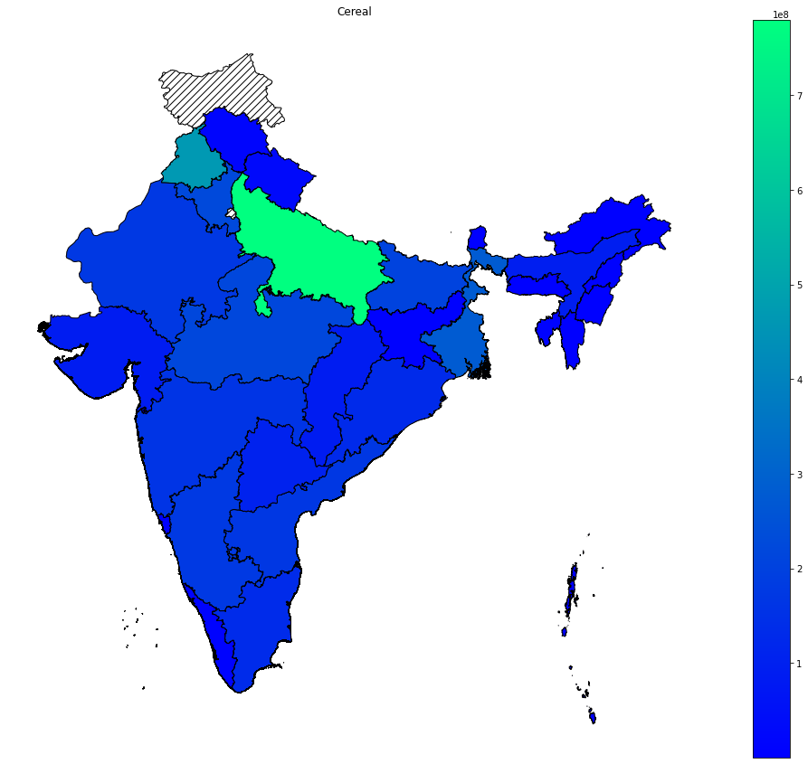
Images

Slide 10
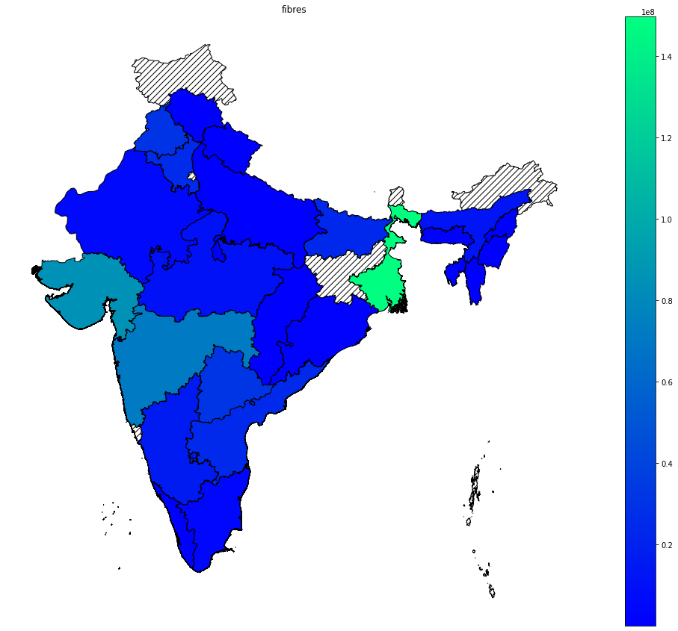
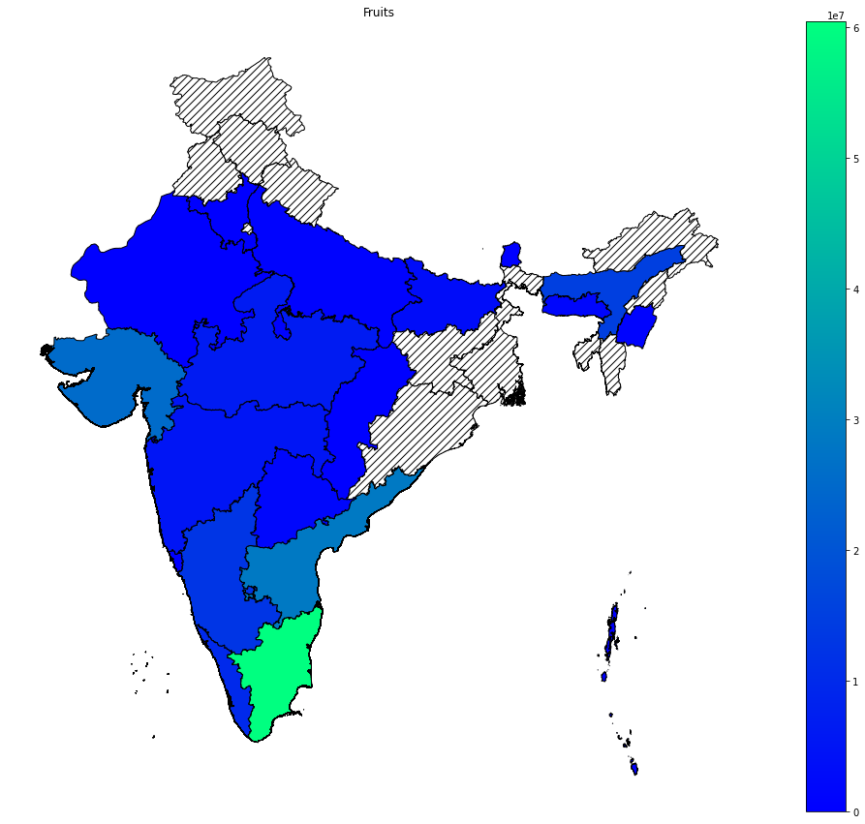

Slide 11
Future Work:
This analysis is just a tip of iceberg, with nineteen year crop production data, a lot could be done and some of the ideas are:
* Instead of deleting missing data for Production(3730 data points), we could impute based on the area used for cultivation and state.
* Zone wise cultivation status and predict future production prediction using regression.
* Crop Categories and status of their cultivation over the years, if the production has gone up (Good case scenario) and if production is gone down (bad case scenario)...can we look into the causation of this trend.
* Asking further important questions like, Kerela is low in area coverage compared to other southern states but still in production levels its high why?

Slide 12
Thank you!

